Slide 1
Capstone Engagement
Assessment, Analysis, and Hardening of a Vulnerable System

Slide 2
Table of Contents
This document contains the following sections:
01
Network Topology
02
Red Team: Security Assessment
03
Blue Team: Log Analysis and Attack Characterization
Hardening: Proposed Alarms and Mitigation Strategies
04

Slide 3
Network Topology
‹#›

Slide 4
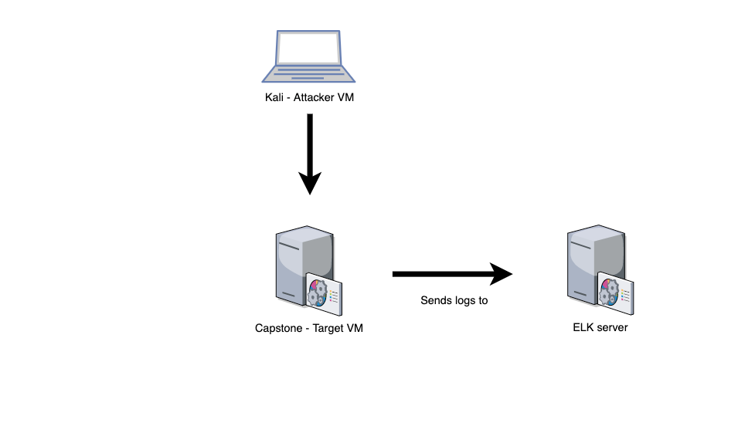
Network Topology
Network
Address Range:
192.168.1.0/24
Netmask:
255.255.255.0
Gateway:
192.168.1.1
Machines
IPv4:192.168.1.90
OS:Linux
Hostname: Kali
IPv4:192.168.1.105
OS:Linux
Hostname:Capstone
IPv4:192.168.1.100
OS:Linux
Hostname:ELK
IPv4:192.168.1.1
OS:Windows
Hostname:ML-REFVM-684424

Slide 5

Red Team
Security Assessment
‹#›

Slide 6
Recon: Describing the Target
Nmap identified the following hosts on the network:
Hostname | IP Address | Role on Network
Router - Hyper V Manager (ML-Refvm-684427) | 192.168.1.1 | Local Host Machine Software that virtualized hardware into virtual machine or servers
Kali | 192.168.1.90 | Attacker Machine using Kali Machine
Capstone | 192.168.1.105 | Victim Machine using Apache web server
ELK | 192.168.1.100 | Monitoring Machine and Log Collection service to identify problems in a server and application

Slide 7
Vulnerability Assessment
Part 1 - Open Access
Vulnerability | Description | Impact
#1 - Open Port | Open Ports can allow attackers to access private information and increase the risk of a breach. | This allowed the red team access via port 80 to find private directory with accessible files.
#2 - Accessible | Web servers, FTP servers, and similar servers may store a set of files underneath a “root” directory that is accessible to the servers users. | This allowed the red team to view the files after accessing the IP on port 80 on chrome from there, the red team obtained the servers users and secret file information.

Slide 8
Vulnerability Assessment
Part 2 - Passwords
Vulnerability | Description | Impact
#3 - Brute Force Attack Password | When the password is easy to guess. It can be found in a brute force tool wordlist to be hacked. | This allowed the red team to brute force Ashton’s password, which was Leopoldo, and access the secret files in the system.
#4 - Hashed Password | A hashed password can be cracked through different tools like John the Ripper, hashcat, and other online tools. It can take only minutes to crack it, if the password is not salted. | This allowed the red team to use md5cracker to identify the password for John, which was Linux4u

Slide 9
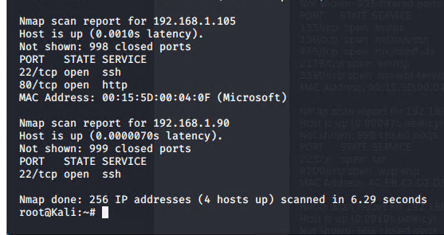
Exploitation #1: Open Port
01
Tools & Processes
Using nmap, scan for any open ports and services in the Network.
02
Achievements
IP address 192.168.1.105 had an open port 80, through which directory with important files were accessible.

Slide 10
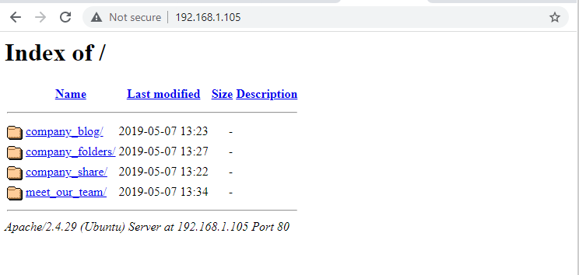
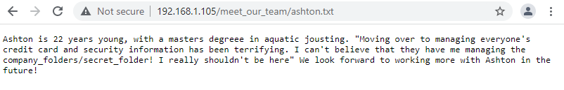
Exploitation #2: Accessible Files
01
Tools & Processes
Using the open port 80, a web browser was used to explore for information.
02
Achievements
Accessing the files gave me intel on which users had access to what and that where their secret files were located.

Slide 11
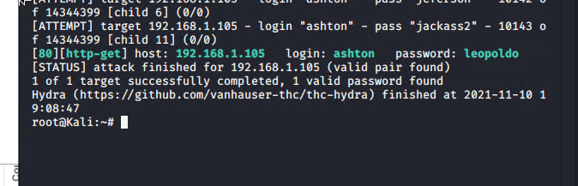
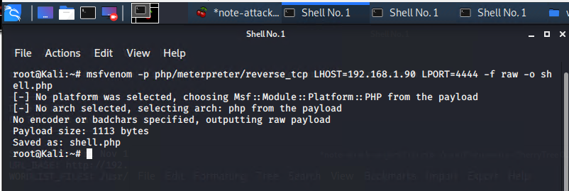
Exploitation #3: Brute Force Attack Password
01
Tools & Processes
Using the Hydra tool to brute force Ashton’s password using the username: ashton.
02
Achievements
The exploit granted user shell access into the victim machine to navigate to the secret files.

Slide 12
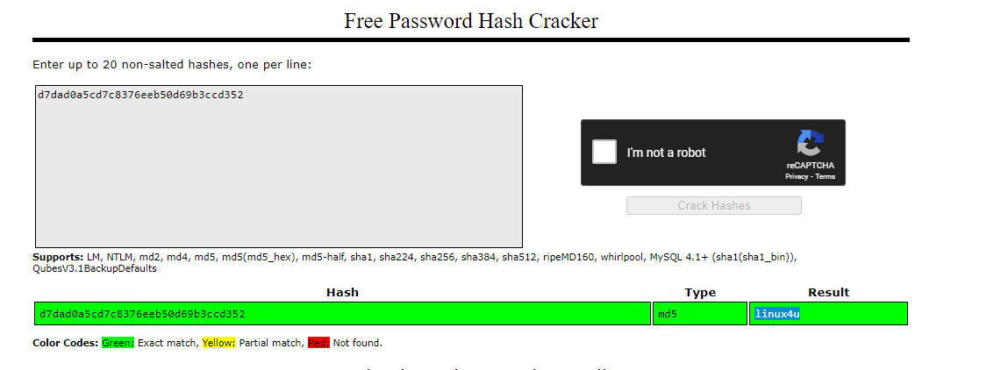
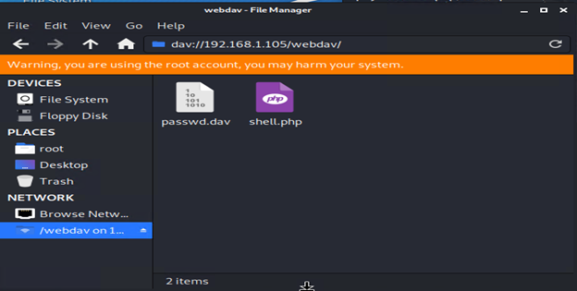
Exploitation #4: Hashed Password
01
Tools & Processes
Using the website md5cracker to find the plaintext of the hashed password for Ryan.
02
Achievements
This password granted access to the system through the webDav connection, which allowed the upload of a shell script to attack.

Slide 13

Blue Team
Log Analysis and Attack Characterization
‹#›

Slide 14

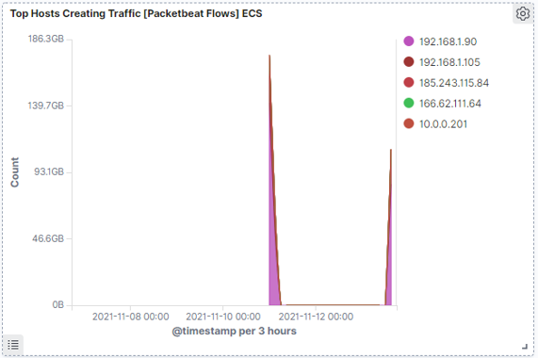
Attack Analysis #1: Identifying the Port Scan
.
Nearly 200,000 hits were sent from 192.168.1.90
The nmap ping scan sent requests to the 443 port, displayed in the chart below.

Slide 15
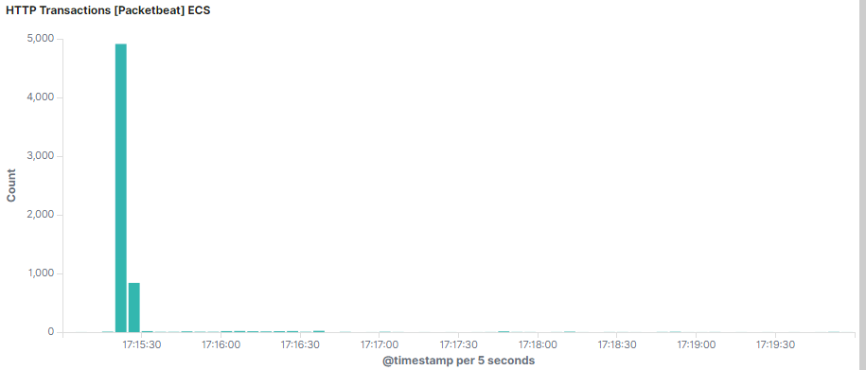
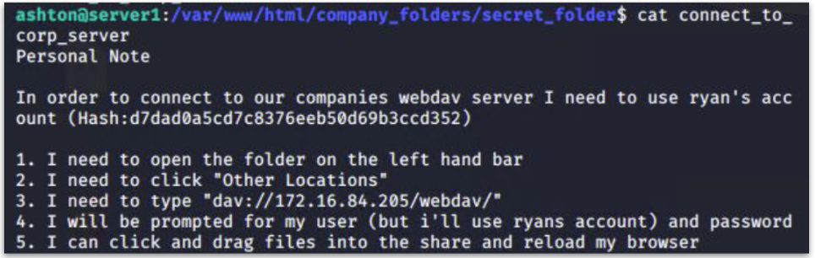
Attack Analysis #2: Request for Hidden Directory
Nearly 5,000 requests for the hidden directory occurred at 5:15pm
The file requested was a secret folder hidden within the company folders.
The secret folder contained instructions on how to access the webdav server using Ryan’s account.
The secret folder also included a hashed password.

Slide 16
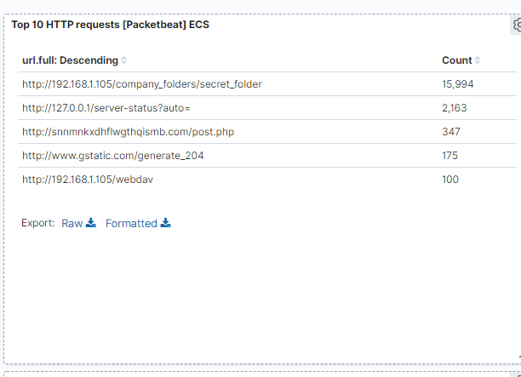
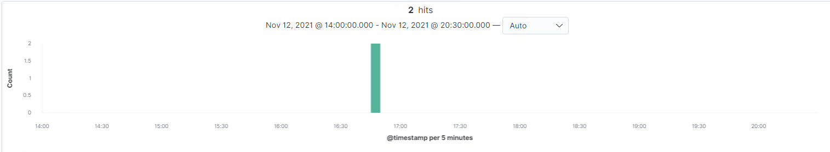
Attack Analysis #3: Uncovering the Brute Force Attack
Over 15,000 requests were made during the attack
From the 15,000+ requests for password protected secret_folder, only 2 were successful considering the file inside the directory.

Slide 17
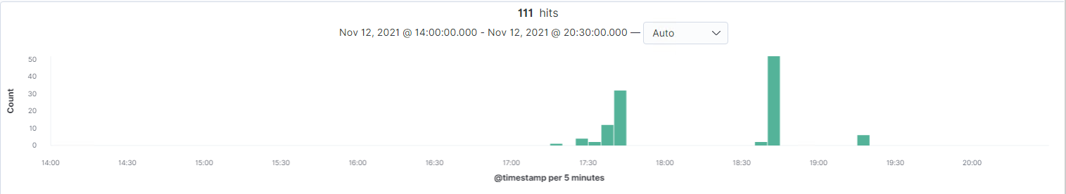
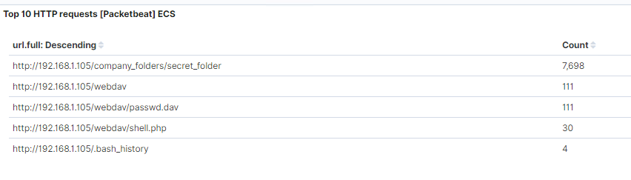
Attack Analysis #4: Finding the WebDAV Connection
Requests to the webDav directory totaled over 100.
The shell.php file was requested 30 times and was a part of the red team’s shell attack to start listening for activity on the victim machine.
[Insert Here]
Add a screenshot of Kibana logs depicting the WebDAV connection.

Slide 18
System Hardening
Proposed Alarms and Mitigation Strategies
‹#›

Slide 19
Mitigation Strategy #1: Blocking the Port Scan
Set an alarm to send an [email, text, console] alert when a firewall detects consecutive scan requests.
Initial threshold:
more than 10 port scans in a minute
more than 100 consecutive requests.
Most firewalls can detect such scanning, allowing intervention in real time.
Enable only the traffic you need to access internal hosts and deny everything else.
Disable ICMP (ping) request/response - especially for port 80.

Slide 20
Mitigation Strategy #2: Identify Request for Hidden Directory
Set an alarm to send an [email, text, console] alert in the event of any attempt to access this directory or files.
Initial threshold: more than one attempt.
Identify if external access to the directory is necessary. (Risk analysis)
If possible, remove the directory and file from the server.
If necessary, move the directory to a safer location or offline location.

Slide 21
Mitigation Strategy #3: Preventing Brute Force Attacks
Set an alarm to send an [email, text, console] alert in the event ‘401’ Unauthorized is returned from any server (that would reduce false alarms for legitimate forgotten password).
Initial threshold: 10 attempts in one hour.
In addition, set an alarm for the ‘user_agent,original’ value includes ‘Hydra’.
Initial threshold: one value
Implement rules to revoke access for a specified period of time following ‘401’ unauthorized attempts (e.g., automatically drop traffic from the offending IP address for period of one hour).
Display a lockout message and lock the page from login for a temporary period of time from users with multiple attempts.

Slide 22
Mitigation Strategy #4: Detecting WebDAV Connections
Set an alarm to send an [email, text, console] alert anytime this directory is accessed by a machine other than those explicitly identified as requiring access.
Initial threshold: more than one attempt.
Remove accessibility to this shared folder from the web interface.
Connections to this shared folder could be restricted by machine with a firewall rules.

Slide 23
Mitigation: Identifying Reverse Shell Uploads
Set an alarm to send an [email, text, console] alert any time ‘.php’ file is uploaded to a server.
Initial threshold: every attempt.
Set an alarm to send an [email, text, console] alert for traffic moving over ports such as “4444” that are default ports for tools such as metasploit.
Initial threshold: every attempt.
Remove access to upload files to this directory over the web interface.
Intentionally restrict or block access as possible.

Slide 24
Review
This presentation identified:
01
Network Diagram
02
Red Team: Security Assessment - Vulnerabilities and Exploitations
03
Blue Team: Log Analysis and Attack Characterization
Hardening: Proposed Alarms and Mitigation Strategies
04

Slide 25
Questions?

